Slide 1


Cycling Transportation in Toronto
By: Shimon Nauenberg and Sagnik Adusumilli

Slide 2
Domain
Data related to cycling transportation in Toronto
Collected From Toronto’s Open Data Portal
Bike Parking, TTC Stations, Traffic Volume, Bikeshare Stations

Slide 3
Questions
Do streets with bike lanes report more traffic volume?
We dropped this question.
Is there a relationship between the areas with more biking parking spots and number of traffic lights?
Which streets are best for biking under different criteria, such as less traffic lights, parking availability etc.?
Are people using bike share stations to get to TTC subway stations?
Do bike share station decrease the average traffic volume at intersections.

Slide 4
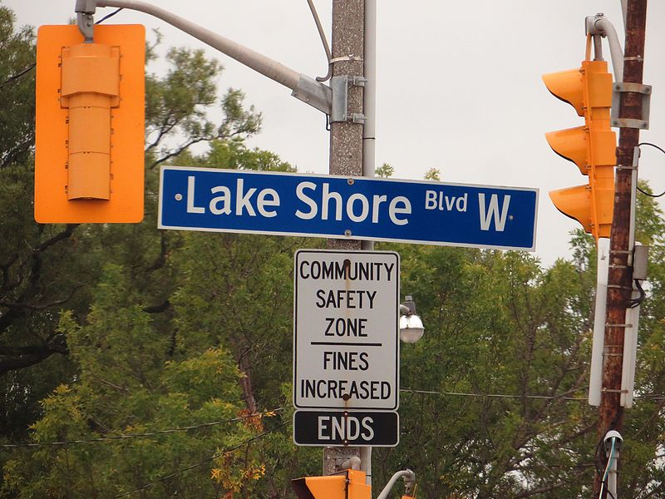
Results
Ranked streets based on the number of traffic lights, number of bike parking spots, number of bike shops and the number of bike share stations .
Five of the best streets to Bike are :
Davenport Road
Lake Shore Boulevard West
Carlton Street
King Street West
Elizabeth Street
These results align nicely with our experience of bike usage on some of these streets.

Slide 5
Challenges
We had to put all the sources in one place. We had about 9 different sources of data.
Cleaning and extracting summary statistics from the bike station data was difficult. We used many methods in R to get this data cleaned and usable.
We had several sources of data instead of one CSV file. This increased the complexity of the schema design. We were hoping that there will would be an unique identifier for location of objects like St number and St Name.
However this identifier was not common and some had unexpected formats for address. We used IDs as keys in some places to work around this issue.
Difficulties with bike station data.

Slide 6
Lessons
Break up relations into smaller relations to avoid redundancy.
Joins can be expensive. It is perhaps a good idea to get as much summary statistics in the cleaning process, and to do joins once.
Data that is not stored in a DBMS can be very messy and be riddled with inconsistencies .
It is important to understand the domain especially when determining keys.

Slide 7
Questions?

